Slide 1
بسم اللہ الرّحمٰن الرّحیم

Slide 2

EE213 Computer organization and assembly language
FALL 2018

Slide 3
Interrupts and Related Concepts

Slide 4
Outlines (Coverage From Text and Reference Book)
Introduction
Memory Mapped Vs Port Mapped I/O (17.5)
IN and OUT Instructions (17.5.1)
Interrupts
Interrupt Handling (17.4)
Interrupt Numbers (Appendix D)
Notes:
The details you learn in this chapter are how arguments are passed by value and by reference, how local variables are created and destroyed, and how recursion is implemented.

Slide 5
Introduction
We have seen instructions to:
Transfer information between the processor and the memory.
However, Input/Output operations which transfer data from the processor or memory to and from the real world are essential.
Generally, the rate of transfer from any input device to the processor, or from the processor to any output device is likely to the slower than the speed of a processor.
it necessary to create mechanisms to synchronize the data transfer between them.

Slide 6
Accessing I/O Devices (Memory-Mapped VS Port-Mapped I/O )
Microprocessors normally use two methods to connect external devices: memory mapped or port mapped I/O.
Memory-Mapped I/O
I/O devices and the program memory may share the same address space.
Any machine instruction that can access memory can be used to transfer data to or from an I/O device. (e.g. MOV instruction).
A program can write data to a particular memory address, and the data is transferred to the output device.
Similarly, data can be read from an input device by copying data from a predefined memory address.

Slide 7
Port Mapped I/O
I/O devices and the program memory have different address spaces.
Port mapped I/O uses a separate, dedicated address space.
Special instructions to transfer data to and from I/O devices
accessed via a dedicated set of microprocessor instructions.
This is usually accomplished by having a different set of signal lines to indicate a memory access versus a port access.

Slide 8
Memory-mapped IO | Port-mapped IO
Same address space to address memory and I/O devices | Different address spaces for memory and I/O devices
Access to the I/O devices using regular instructions | Uses a special class of CPU instructions to access I/O devices
Most widely used I/O method | x86 Intel microprocessors - IN and OUT instructions

Slide 9
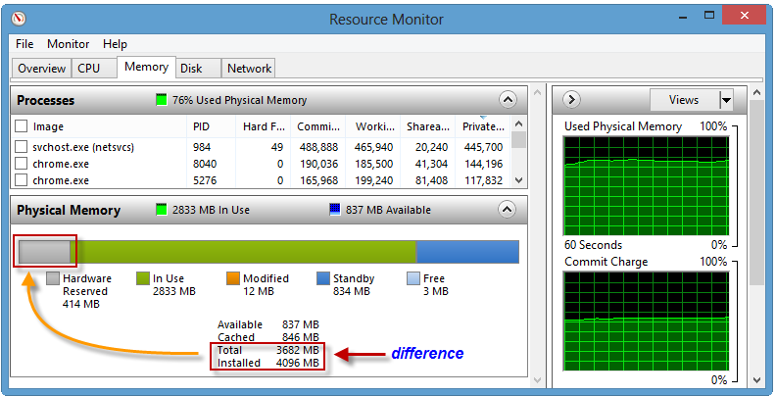

Slide 10
I/O Ports
Alternatively referred to as I/O address, I/O ports, and I/O port address, the input/output port is what allows the software drivers to communicate with hardware devices on your computer.
In your computer there are 65,535 ports that are numbered from 0000h to FFFFh.

Slide 11
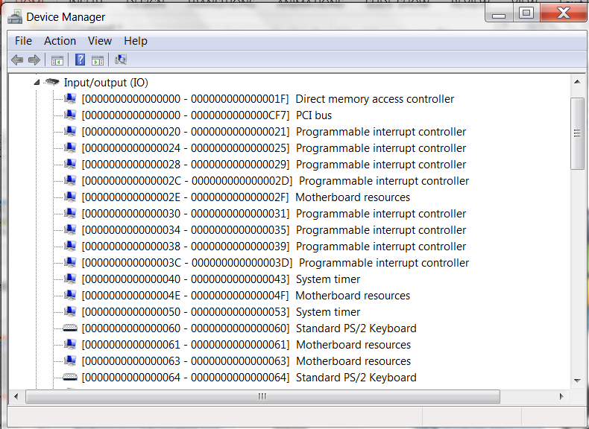

Slide 12
IN and OUT Instructions
The IN instruction inputs a byte, word, or doubleword from a port.
Conversely, the OUT instruction outputs a value to a port.
Port may be a constant in the range 0 to FFh, or it may be a value in DX between 0 and FFFFh.
Accumulator must be AL for 8-bit transfers, AX for 16-bit transfers, and EAX for 32-bit transfers.
IN accumulator, port OUT port, accumulator

Slide 13
in al,3Ch
out 3Ch,al
mov dx, portNumber
in ax,dx
out dx,ax
in eax,dx
out dx,eax

Slide 14
Programmed I/O (Keyboard attached to 03F8h)
MOV ESI, 0
MOV ECX, 100
MOV DX, 3F8h
L1: IN AL, DX
MOV SampleArray[ESI], AL
INC ESI
LOOP L1
POLLING
Notes:
Polling, or polled operation refers to actively sampling the status of an external device by a client programS as a synchronous activity.

Slide 15
Interrupts
When accessing I/O devices Program-controlled I/O is the approach where processor repeatedly monitors the status of device, it does not perform any useful tasks.
Processor polls the I/O device.
An alternate approach would be for the I/O device to alert the processor when it becomes ready.
Do so by sending a hardware signal called an interrupt to the processor.
At least one of the bus control lines, called an interrupt request line is dedicated for this purpose.
Processor can perform other useful tasks while it is waiting for the device to be ready
Notes:
Polled IO versus Interrupt Driven IO

Slide 16
Polled I/O Vs Interrupt Driven I/O
With Polled I/O processor continually checks I/O devices to see it is ready for data transfer.
Inefficient
Interrupt driven I/O – I/O device interrupts processor when it is ready for data transfer.
Processor can do other jobs while waiting for last data transfer to complete.

Slide 17
Types of Interrupts (YTHA YU, CHArles MARUT AsM BOOK)
Hardware Interrupts (Interrupts)
Used by devices to communicate that they require attention.
hardware interrupt is generated by the Intel 8259 Programmable Interrupt Controller (PIC), which signals the CPU to suspend execution of the current program and execute an interrupt service routine.
Software Interrupts (Traps)
Software interrupts are used by programs to request system services.
Software interrupt occurs when a program calls an interrupt routine using the INT instruction.

Slide 18
Interrupts Handling
An interrupt alerts the processor for an immediate response.
The processor responds by suspending its current activities, saving its state, and executing a function called an interrupt handler (or an interrupt service routine, ISR) to deal with the event.
An interrupt handler or interrupt service routine (ISR) is the function that is executed by OS in response to a specific interrupt.
Interrupt numbers are used by devices to identify their own service routines.
Not every interrupt number has a corresponding interrupt routine
One interrupt number may have multiple functions, identified by function number. (e.g. INT 21h, see Appendix-D).

Slide 19
Interrupt handler (interrupt service routine) – performs common I/O tasks
can be called as functions
can be activated by hardware events
Examples:
video output handle
critical error handler
keyboard handler
divide by zero handler
Ctrl-Break handler
serial port I/O

Slide 20
What happens when InterRupt occurs
Processor received Interrupt
Save context (return address, registers, flags, etc.) and JMP to ISR
Interrupt Service Routing (ISR) or Interrupt Handler is execute
IRET instruction is last in the ISR and it returns controls to the main program.
The transfer to an interrupt routine is similar to a procedure call.
Interrupt-service routine and the program that it interrupts may belong to different users
Before branching to the interrupt-service routine, information such as condition code flags, and processor registers used by both the interrupted program and the interrupt service routine must be stored

Slide 21
The 8086 does not generate the interrupt routine's address directly from the Interrupt number.
Doing so would mean that a particular interrupt routine must be placed in exactly the same location
This means that the routine may appear anywhere in the memory, therefore, its address, called interrupt vector, is stored in a predefined memory location.
All interrupt vectors are placed in an interrupt vector table.

Slide 22
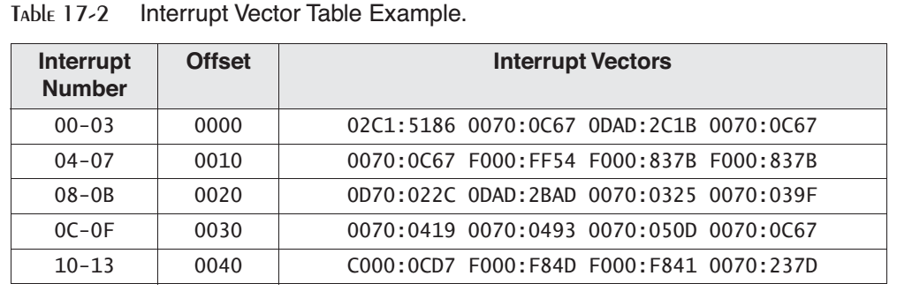
Each entry in the table (interrupt vector) is a 32-bit segment-offset address that points to one of the existing service routines.

Slide 23
IRQ Levels (interrupt request level)
Interrupts can be triggered by a number of different devices on a PC.
Each device has a priority, based on its interrupt request level (IRQ).
Level 0 has the highest priority, and level 15 has the lowest.
Prevents low-priority interrupt from interrupting a high-priority interrupt.

Slide 24
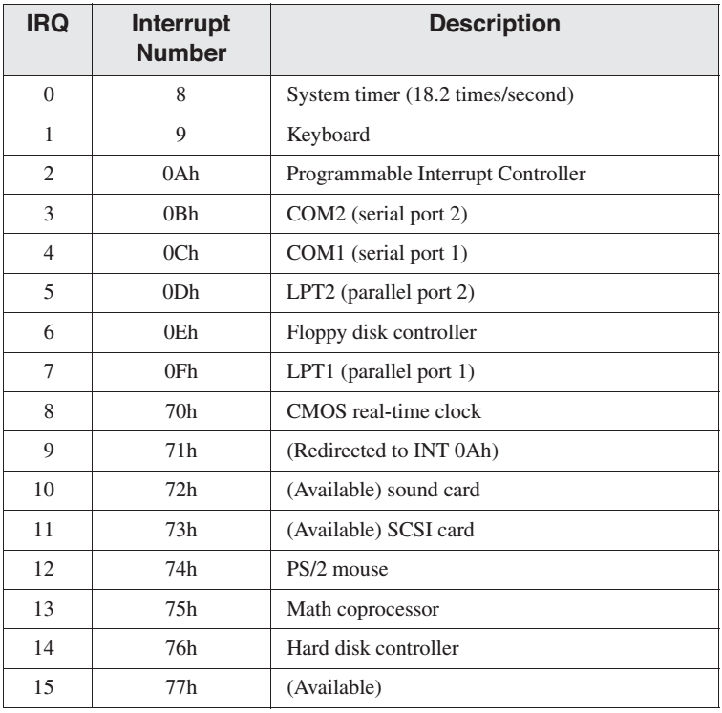

Slide 25
Thus an interrupt handler is executed if:
An application program executes INT instruction. Or
when a hardware device sends a signal to the Programmable Interrupt Controller chip.
Occasionally, programs must disable hardware interrupts (Interrupt Disabling) when performing sensitive operations on segment registers and the stack.

Slide 26
Interrupt Control Instructions
STI Instruction
The STI instruction enables external interrupts.
For example, the system responds to keyboard input by suspending a program in process and doing the following: It calls INT 9, which stores the keystroke in a buffer and then returns to the current program.
Normally, the Interrupt flag is enabled. Otherwise, the system timer would not calculate the time and date properly, and input keystrokes would be lost.

Slide 27
Interrupt Control Instructions
CLI Instruction
The CLI instruction disables external interrupts.
It should be used sparingly, only when a critical operation is about to be performed, one that cannot be interrupted.
cli ; disable interrupts
mov ax,mystack ; reset SS
mov ss,ax
mov sp,100h ; reset SP
sti ; reenable interrupts

Slide 28
Interrupts should not be disabled for more than a few milliseconds at a time, or you may lose keystrokes and slow down the system timer.
When the CPU responds to an interrupt handler, other interrupts are immediately disabled.
MS-DOS and BIOS interrupt service routines reenable interrupts as soon as they begin to execute.

Slide 29
E.G. keyboard Interrupt
When a key is pressed, the 8259 PIC sends an INTR signal to the CPU, passing it the interrupt number.
if external interrupts are not currently disabled, the CPU does the following, in sequence:
Pushes the Flags register on the stack.
Clears the Interrupt flag, preventing any other hardware interrupts.
Pushes the current CS and IP on the stack.
Locates the interrupt vector table entry for INT 9 and places this address in CS and IP.

Slide 30
Next, the BIOS routine for INT 9 executes, and it does the following in sequence:
Re-enables hardware interrupts so the system timer is not affected.
Inputs a scan code from the keyboard port, attempts to convert it to an ASCII character, or assigns an ASCII code equal to zero. It then stores the scan code and ASCII code in the keyboard buffer.
Executes an IRET (interrupt return) instruction, which pops IP, CS, and the Flags register off the stack.
Control returns to the program that was executing when the interrupt occurred

Slide 31
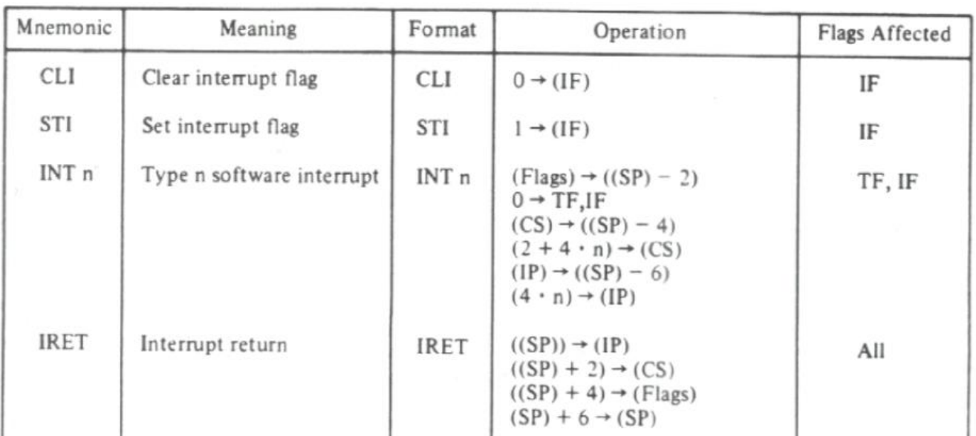

Slide 32


